Slide 1
UNIVERSAL VERIFICATION METHODOLOGY

Slide 2
Concepts
UVM Overview
UVM Library Basics
Interface UVCs

Slide 3
UVM Overview

Slide 4
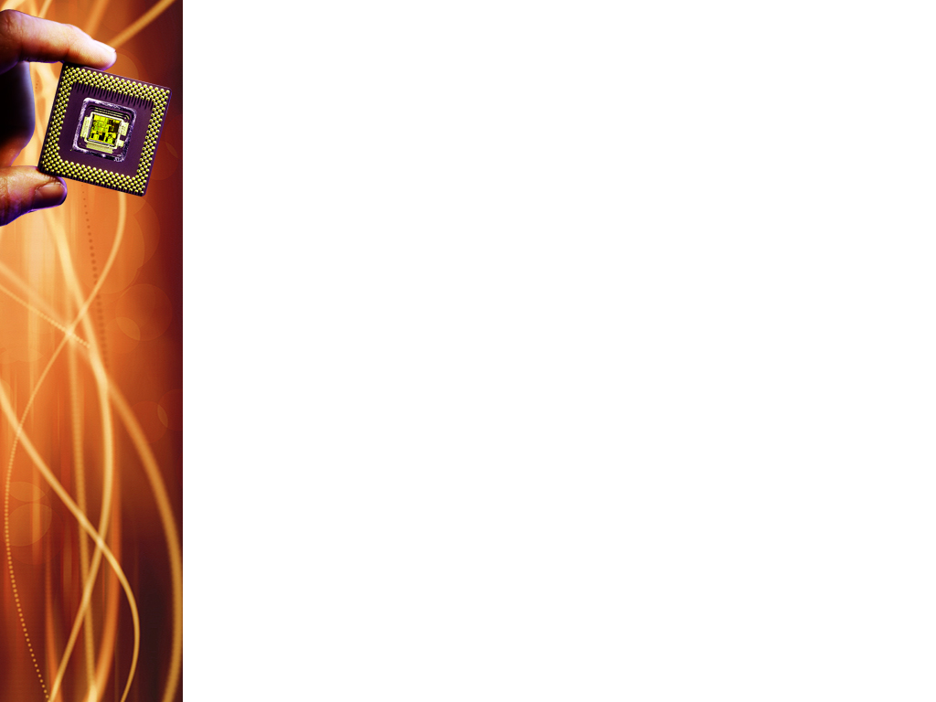
Verification Plan
Identifying what features of the DUT need to be verified
Use of static formal verification, simulation, emulation, or FPGA prototyping
Coverage data is collected and monitored
Exists as a spreadsheet, a series of documents, or a special purpose tool (helps to write, refine, & maintain plan)
Coverage driven verification wrt UVM focuses on simulation-based verification environment.
Notes:
Verification planning and management involves identifying the features of the DUT that need to be verified, prioritizing those features, measuring progress, and adjusting the allocation of verification resources so that verification closure can be reached on the required timescale.
The verification plan does not contain the actual tests, but it may state the approach that is to be taken. verification can be accomplished using static formal verification (also known as property checking), simulation, emulation, or FPGA prototyping
During development of the verification plan, other information may be added such as the development strategy for the testbench components, the priorities of certain features, schedules and verification IP components that are to be used.

Slide 5
Coverage-driven Verification
Classical Constrained Random Verification
Starts with random stimulus
gradually tightens constraints until coverage goals are met
relies on brute power of randomization & compute server farms to cover state space
UVM directly supports this
Graph based stimulus generation
Known as Intelligent TB
starts from an abstract description of legal transitions between high level states of DUT
Automatically enumerates minimum set of tests needed to cover the path through this state space
Can achieve high coverage in far fewer cycles than constrained random
Separate, dedicated tool required for this
Notes:
CRV uses powerful randomization and extensive compute resources to explore and test different scenarios within the system’s possible states.
1. While UVM directly supports the constrained, random verification, graph-based stimulus generation requires a separate, dedicated tool. Stimulus generated from the graph-based approach can be executed on a UVM verification environment.

Slide 6
Functional & Code Coverage
FUNCTIONAL COVERAGE
attempts to measure if features in verification plan have actually been executed by DUT
qualitative measure
CODE COVERAGE
measures the execution of actual RTL
includes statement & branch coverage, state & state transition coverage
is largely automatic
quantitative measure
Notes:
Since code coverage measures the execution of the actual RTL, the RTL code must therefore exist before code coverage can be run at all. Code coverage can be considered as a quantitative measure of DUT code execution.
The features to be measured in functional coverage have to be brainstormed from the specification and implementation of the design to create the verification plan, and so functional coverage can be considered as a qualitative measure of DUT code execution.
It is quite possible to achieve 100% code coverage but only 50% functional coverage, for example when the design is half complete. Equally, it is possible to have 50% code coverage but 100% functional coverage, which might indicate that the functional coverage model is missing some key features of the design. The two coverage approaches are complementary, and high quality verification will benefit from both.

Slide 7
Functional Coverage
Functional coverage helps identify:
which features in the verification plan have been tested successfully
which features in the verification plan have not yet been tested and thus require further work
what proportion of the features have been tested and thus how close the verification process is complete
the set of tests that provide maximum coverage using the minimum number of CPU cycles
confidence that previously fixed design bugs have not been reintroduced into the design

Slide 8
Coverage Model
Verification plan
Features to be verified
CODE Coverage information
Sample based property based code
(SV covergroups) (SV cover property)
Notes:
The verification plan is implemented by converting each feature into code to collect coverage information, otherwise known as the coverage model.
This can be a combination of sample-based coverage (SystemVerilog covergroups), property-based coverage (SystemVerilog cover property statements), and code coverage.
The coverage model should be formally reviewed against the verification plan and the verification plan formally reviewed against the design specification before coverage collection starts.
Effective verification planning and management relies on a combination of functional coverage, code coverage, and automated checking.
A feature can only be considered covered when the design works correctly: Failed tests should not contribute toward the cumulative coverage record. Self-checking verification environments are critical to the coverage-driven verification methodology. Checks can be performed at all levels in the verification environment including assertions in SystemVerilog interfaces, end-to-end checking in scoreboards, and checks integrated with coverage collection.
Code for the stimulus generation, drivers, monitors, the coverage model and the checkers should be complete and debugged before starting to accumulate functional coverage information: Coverage information collected in the absence of comprehensive checking is meaningless.
During the verification process the same verification environment is executed repeatedly using different tests until the coverage goals are met. One test can differ from another by configuring or constraining the verification environment in a different way or merely by starting simulation with a different random seed. Tests can be graded according to a variety of criteria including functional coverage, bugs detected, and simulation run time. The best-performing tests, according to some combination of these criteria, can then be used as the basis for the regression test suite: You would typically select a set of tests that achieve the maximum coverage in the minimum run time, and discard any tests that do not add to the functional coverage achieved by the best set of tests. Towards the end of the verification process it is possible to arrive at a highly optimized regression test suite.
It is usual to run multiple tests in parallel on compute server farms. The coverage results from individual tests need to be merged together and annotated back onto the verification plan to form a cumulative record of progress. This needs to be done efficiently in order to provide up-to-date information for verification management. Coverage results from failing tests should be excluded from the merge.
Sufficient information should be captured from each test run to allow the simulation run to be reproduced. This information will include the random seed, the revision identifiers of the RTL code and the verification code, and all relevant software version numbers.
Even after extensive random testing, features in the verification plan can remain uncovered for a number of reasons, and the reasons need to be analyzed. Features could be unimplemented, unused or disabled in the product, inadvertently forgotten about, or just very hard-to-reach with random tests. After analysis, features that still remain uncovered can be reached by adding further specific tests. Where practical, it is preferable to adjust the knobs used in the constraints to tighten up random distributions rather than resorting to very specific directed tests.

Slide 9
Essential steps in coverage-driven verification process
Create the verification plan with the involvement of stakeholders
Create the coverage model from the verification plan
Debug the verification environment, checkers, and coverage model
Run tests with multiple random seeds until cumulative coverage flattens off
Annotate coverage results back onto the verification plan
Run further tests with modified stimulus constraints to close coverage holes
Analyze and prioritize any unverified features and allocate resources accordingly
Run directed tests for particularly hard-to-reach coverage holes

Slide 10
What is UVM?
Test benches for Verilog/VHDL/System C/SV designs
UVM has System Verilog Base Class Library (BCL)
Supports Constrained Random Verification
Notes:
UVM is a methodology for writing TBs for design in Verilog/SV/System C. It is aimed at functional verification using SV.
UVM itself in written in SV. One of the main deliverables in UVM is the SV BCL.
Constrained Random Verification is central to UVM

Slide 11
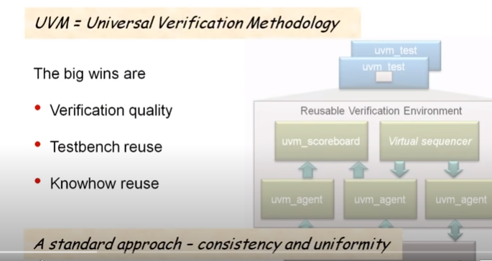
Why UVM?
Notes:
The big wins of UVM are improved verification quality through use of constrained random verification, testbench reuse, and know-how reuse (reuse of UVM knowledge from project to project). UVM achieves these features by having a standard approach allowing you to write consistent and uniform functional verification environments.

Slide 12
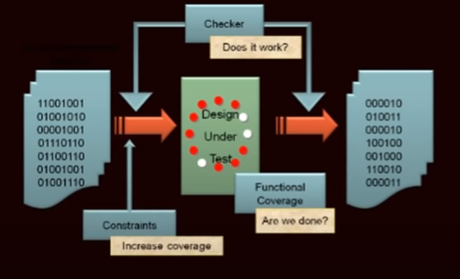
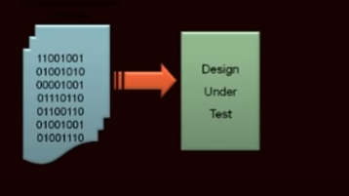

Constrained Random Verification
Simulation is still the workhorse of functional verification.
Notes:
Constrained Random Verification is the idea of using random vectors for simulation.
Randomizing some element of the test vectors thrown into the design during simulation has many benefits:
This finds unexpected bugs in the DUT as against providing planned test vectors that will help find bugs that you intend to look for.
With the advantage of automation of stimulus generation, one can run long, or overnight simulations, or over the weekend simulations over the server farm without having to manually write all the test vectors.
How does constrained random verification work?
Remember the 3 Cs .. Checkers, Coverage, and Constraints. If you use random vectors, you need to automate the checking as well, for which you need to write self-checking TBs in SV.
With checker, you check whether the design really works. With coverage, you check if you are done. If you have coverage holes, then comes constraints into the picture. It will be required to constraint those random vectors to increase the test coverage.
Hence, UVM is a methodology built in SV for doing constrained random verification.

Slide 13
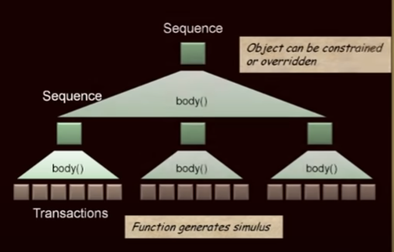
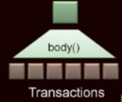
Layered Stimulus
Notes:
UVM features a layered approach in generating test vectors using sequences. A sequence generates transactions. A sequence is also an object that can be manipulated. Hence, a sequence is both a function and an object.
Sequences can be built out of other sequences like a hierarchical or layered structure. They can be instantiated, overwritten, controlled to constrain precisely the test vectors.

Slide 14
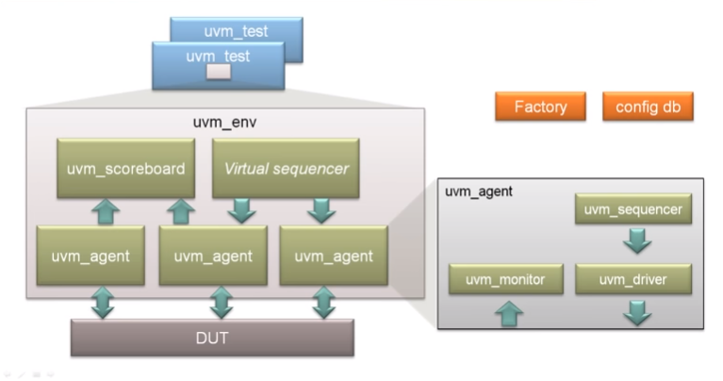
The Big Picture
Notes:
The main advantage of UVM is reuse. UVM offers a standardized consistent structure for the verification components; one of them being the UVM agent. The sequencer generates sequences that generate transactions that are passed down to drivers. The drivers wiggle pins on the DUT. The monitor then extracts transactions and then sends them to the rest of the verification environment.
The UVM component gets reused into a bigger verification environment, and can be configured to the needs of that specific environment. The virtual sequencer is a component that coordinates the activity of other sequencers.
The overall verification environment is reused as per demands of specific tests. The tests are separated from the rest of the reusable environment.
The customization of the uvm agent and uvm environment happen with the use of factory mechanism and configuration db

Slide 15
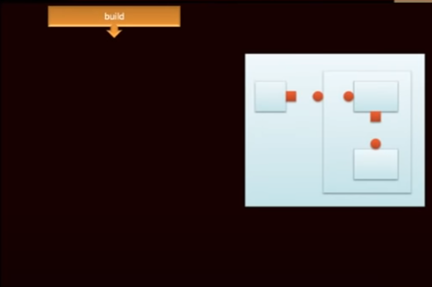

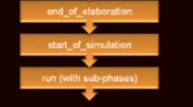
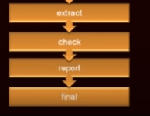
Standardized Execution Phases
Notes:
Execution in UVM starts from the build phase that builds the hierarchical structure of components.
This is followed by the connect phase that connects together ports on those components. The build and connect are like elaboration in VHDL or Verilog.
Then come some house-keeping phases like end of elaboration and start of simulation. This is followed by the run phase where dynamic things happened and sequences execute.
This is followed by some house-keeping phases to tidy things up, such as the extract, check, report, and final.

Slide 16
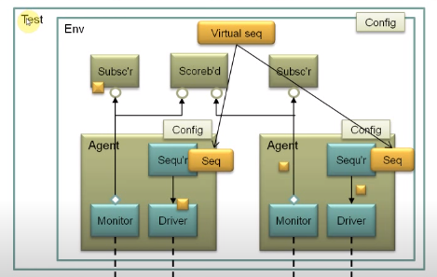
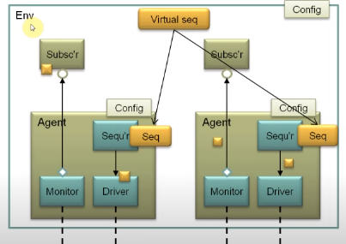
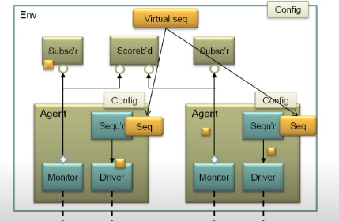
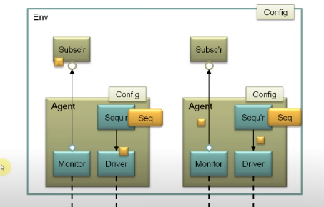
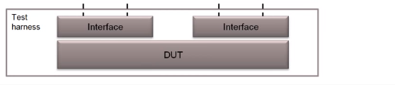
The Bigger Picture
Class
based
Module
based
Notes:
A SV interface (dashed lines are virtual interfaces) can be connected to the main interfaces on the DUT. Hence, the instance of the DUT, the interfaces, and any other supporting circuitry to run the DUT like clock and reset generator are all instantiated within a test harness.
On top of the module based part is the class based UVM verification environment, also called the TB, wherein each component is an object (instantiation of a class). Each interface in the test harness will have a corresponding agent in the class based UVM environment.
The sequencer will run sequences and generate transactions. The monitor then monitors the pin wiggling of the interface pins, assembles the output into transactions and sends it to the rest of the verification env for analysis. The subscriber analyses the output from the DUT.
Each UVM sequence is eventually bound to a UVM sequencer. The sequences are constrained to push the DUT into interesting states to maximize functional coverage. The sequences running on each agent, generating the stimulus or traffic for that particular interface and their behaviour is coordinated from a virtual sequence.
The scoreboard is instantiated when you need to do end-to-end checking.
The env is instantiated within a test which is the top level component.
All connections within the env are transaction level connections (based on the TLM 1.0 standard). Transactions within the env are passed from TLM ports to TLM exports. The case of the monitor uses analysis ports and exports. A single analysis port on the monitor can broadcast transactions to multiple subscribers. Subscribers could be used for functional coverage and scoreboard used for end-to-end checking. Both components could be used for functional coverage as well as checking.

Slide 17
Other Features
TLM Communication (from SystemC)
Message Reporting
End-of-test mechanism (aka objections)
Register Layer (from VMM RAL)
Notes:
Each component raises an objection when it’s busy and drops that objection when it is finished.
RAL – Register Abstraction Layer

